Slide 1


DIT/11/C2/0328
DIT/11/C2/0343
DIT/11/C2/0345
DIT/11/C2/0353
DIT/11/C2/0357
Kirinda G L M
Piumika W M S
Jayarathne R P E T
Thilantha B Y
Chathuranga A W I
Topic : video rental system
Requirement Analysis
__________________
Cinemax Videos
Problems
Requirements
Solution
Advantages
Exit

Slide 2

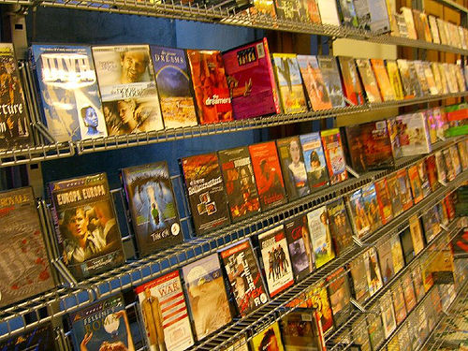
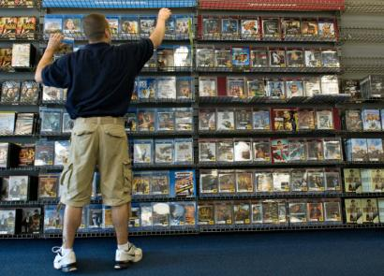
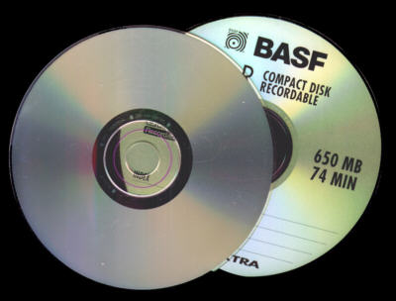

COMPANY BACKGROUND
Name :
Address :
Owner :
Cinemax Videos
ST. Michael's Road, Colombo – 03.
Mr. Parackrama Edirisinghe
This is a Video Rental Company .
They have large amount of VCDs & DVDs
They handle about 500 customers per month
They keep their all data on written papers….!
So it’s not easy to maintain them.
Back

Slide 3



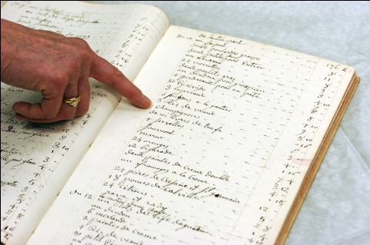
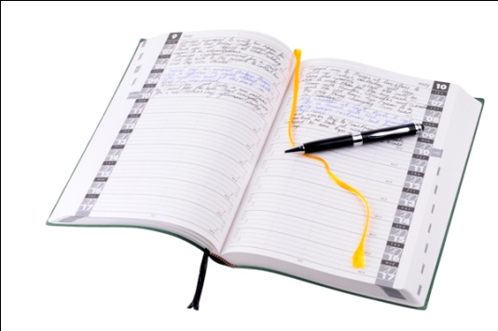

PROBLEMS
Difficult to search details
Stocks are increasing rapidly
Too much customers
Customers do not return videos on time
Time is wasting
Back

Slide 4



REQUIREMENTS
Should be quick & easy to search ,
Customers by ,
Name
Borrowed Date
Deadline Date
NIC No.
Videos by ,
Name
Item No./Copy No.
Release Date
Category
Should be easy to edit these details
Back

Slide 5





SOLUTION
Creating a Database system
Details
Customers
Videos
Customer Name
NIC No.
Phone No.
Address
Item No./Copy No.
Borrowed Date
Video Name
No. of Copies
Release date
Item No.
Copy No.
Language
Category
No. of times Borrowed
Back

Slide 6


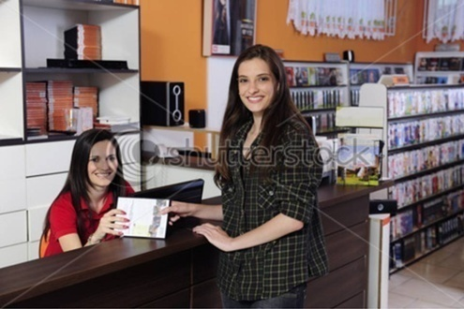



Advantages
Will be quick & easy to search for Details
Data can be edited easily
Can maintain very large amount of data
No more time wasting
Can increase their efficiency
They can buildup their business better & faster
Back
Exit

Slide 7

. . . THANK YOU . . .
………….

